Slide 1
Customer Churn Prediction Using Classification Algorithms and Survival Analysis
August 2024

Slide 2
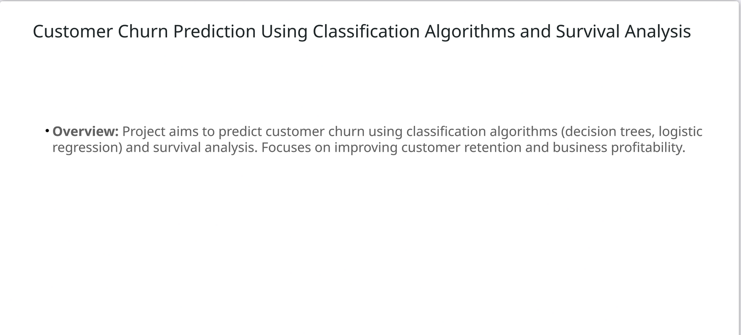

Slide 3
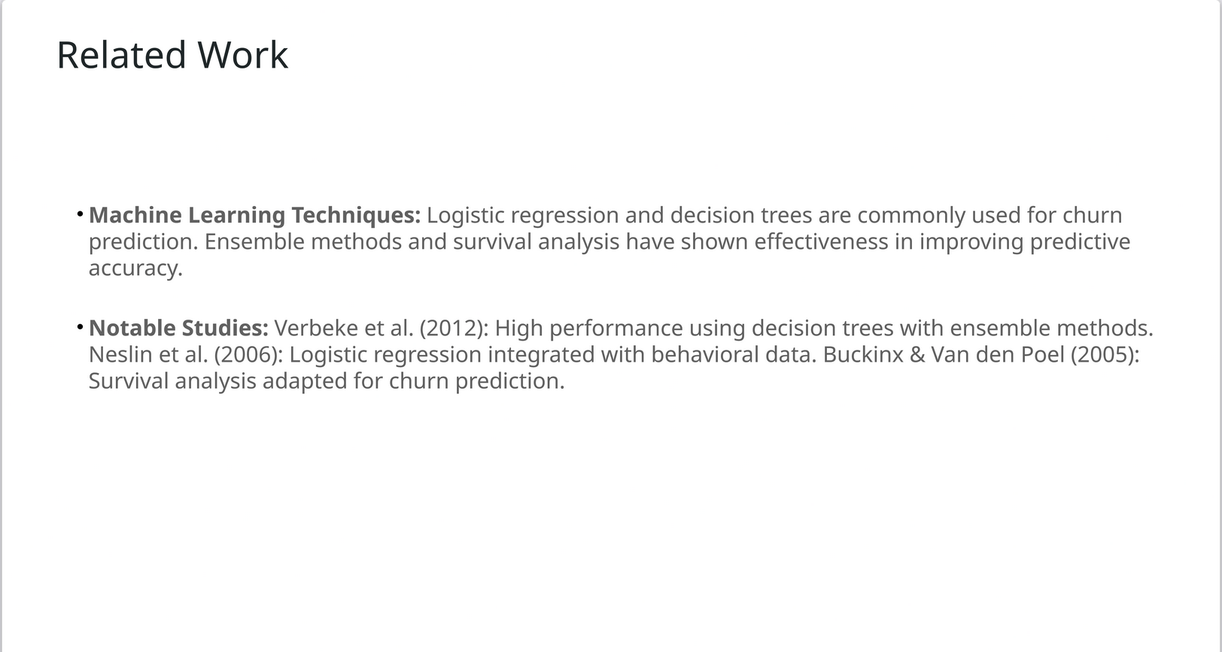

Slide 4
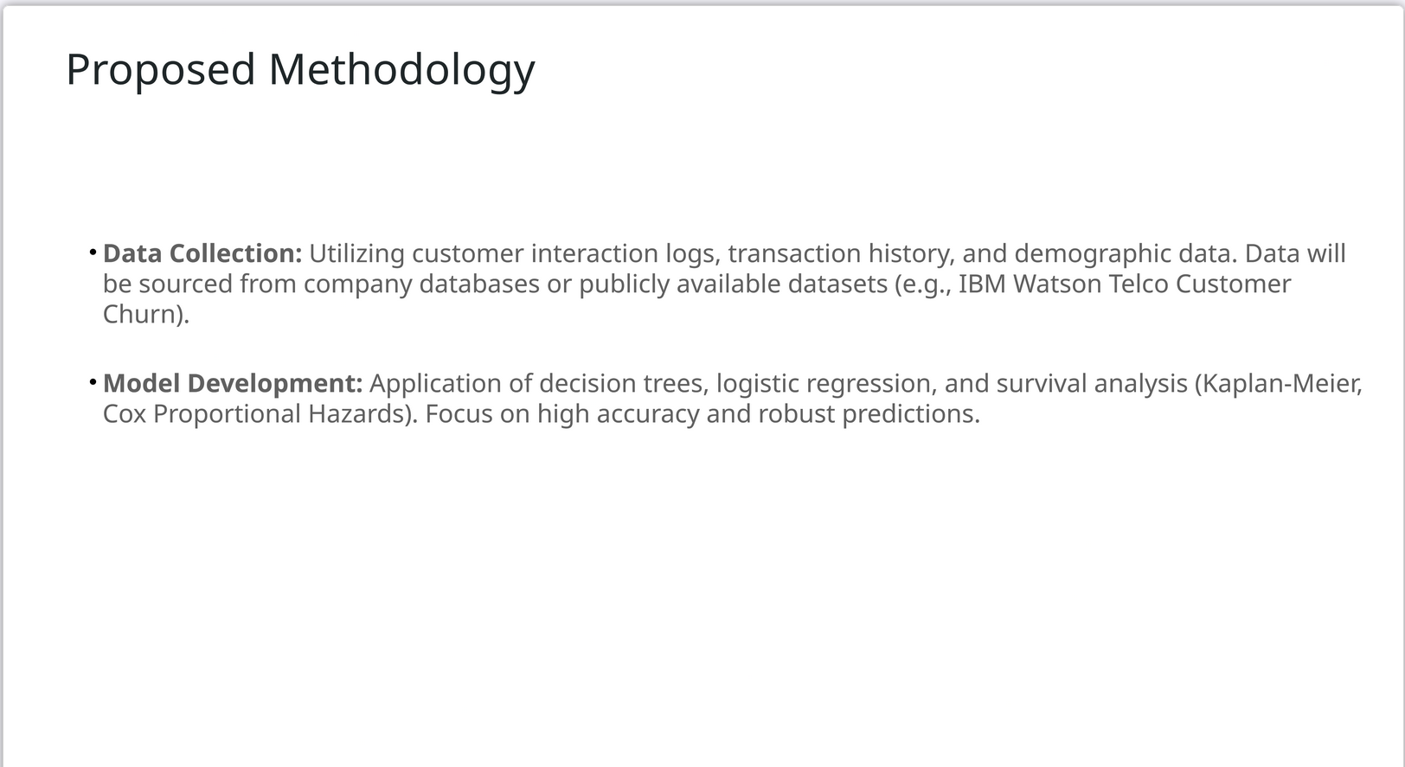

Slide 5
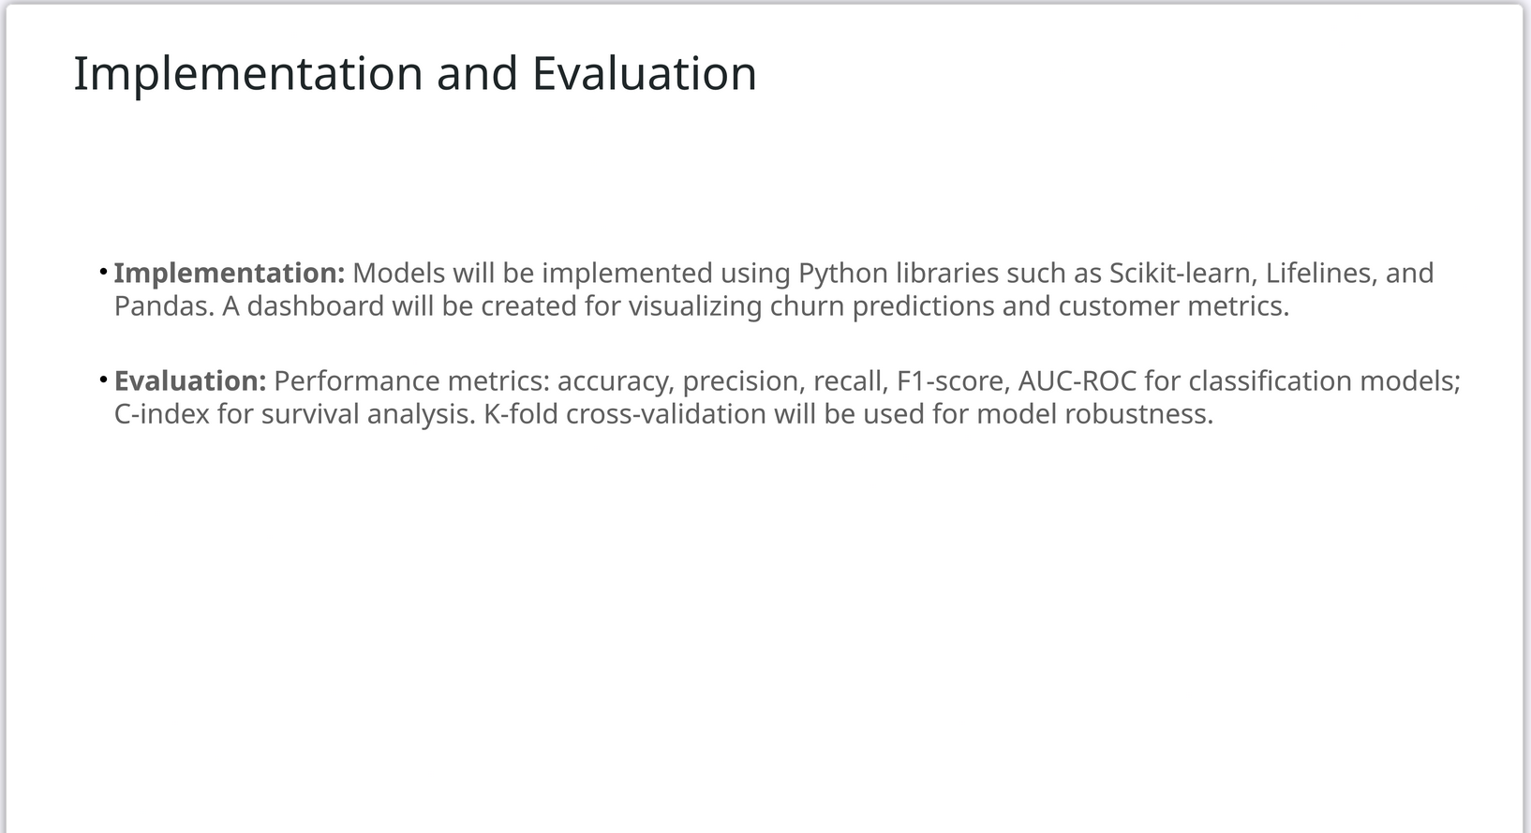

Slide 6
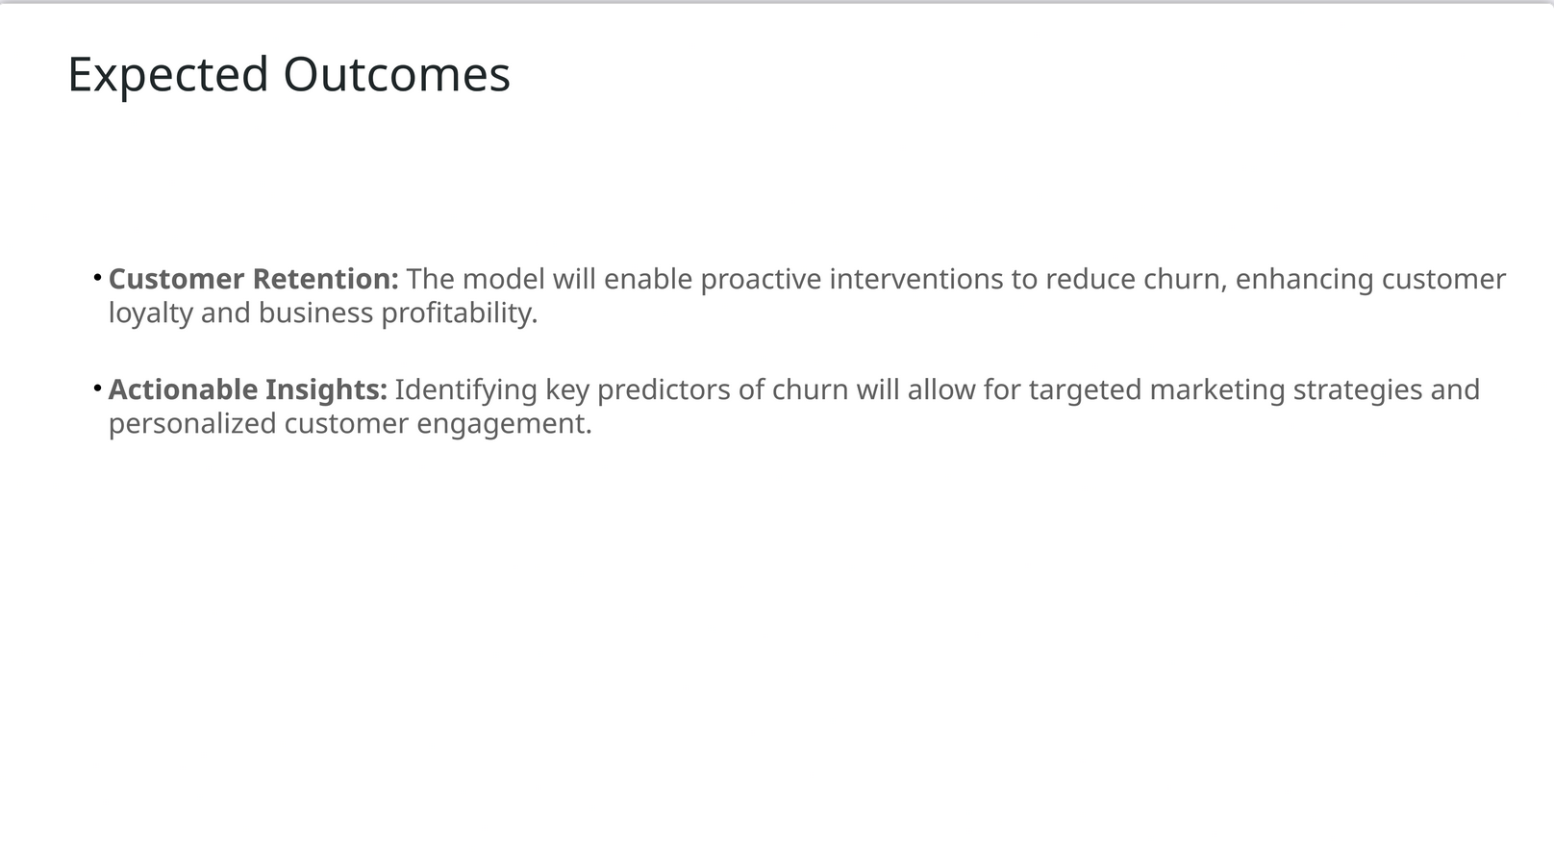

Slide 7
